Slide 1
near-real-time sales Spark Streaming demo
Zhen Xu
12.05.2015

Slide 2
Outline
Motivation
Concepts
Taste on streaming
Streaming Analytics
Stateful Streaming
Future work
Eclipse, sbt, Scala 2.10, spark 1.3, Hadoop 2.6.

Slide 3
Motivation
Lightning discount (time duration only in seconds/minutes) on-line sales is becoming available only in big company as Amazon. It is rare for small online store to add this sales strategy to increase on-line sale.
Real time evaluation of balancing total increase of sales and reasonable discount to attract more sales is challenging. Because huge real-time transaction data and related analysis brings more hardware and software cost.

Slide 4
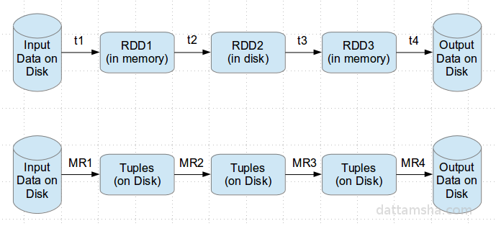
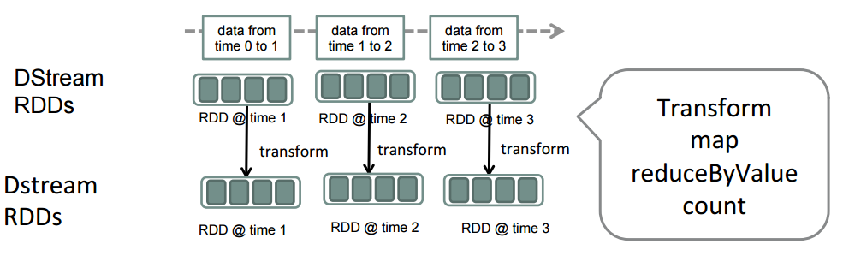
Spark streaming is one of the best choice.
live data stream
Spark
Streaming
batches of X seconds
Spark
processed results

Slide 5
Simulation
This project will demonstrate how to carry out lighting discount strategy in real time according to ranking.
It is impossible for me to get actual real time sales data, so I apply similar process on top of music rank from http://realtime.billboard.com/ and do the simulation on sales discount(rank), copies (discount) relationships.

Slide 6
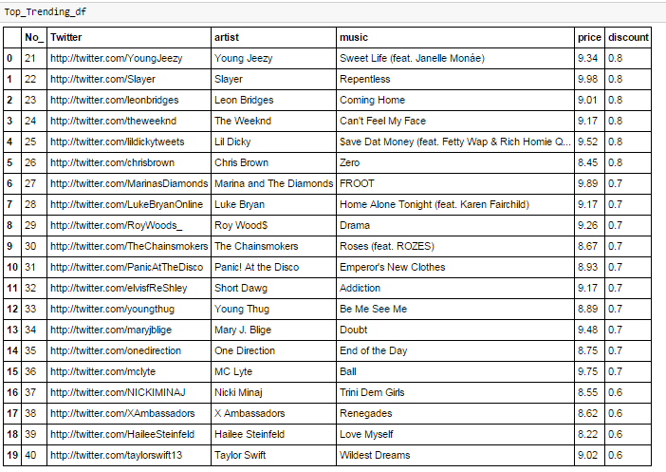
Data-python injection
user, rank, artist, music, price, discount, copies

Slide 7
Periodical read and write
from win32api import *
from time import *
i = 1
#print("The job has been executed", i, "times till now.")
while 1:
%run music_rank-v2-only_result2
print("-------------The job has been executed", i, "times till now.-----------------------",'\n')
i += 1
sleep(30)

Slide 8
Taste on streaming
object SimpleStreamingApp {
def main(args: Array[String]) {
val ssc = new StreamingContext("local[2]", "Streaming App", Seconds(10))
// Create a input stream from TCP source hostname:port
val stream = ssc.socketTextStream("localhost", 9999)
// Simply print out the first few elements of each batch
stream.print()
ssc.start()
ssc.awaitTermination()
}
}
streamingContext:
flumestream
textFileStream
socketTextStream
twitterStream
…
RDD graph
T
Input DStream
M
Mapped DStream
https://spark.apache.org/docs/0.7.3/api/streaming/spark/streaming/StreamingContext.html
E
Foreach DStream

Slide 9
MusicStreamProducer
Maximum number of events per second: 5
def generateSaleEvents(n: Int) = {
(1 to n).map { i =>
val ((((rank,artist), music),price),discount) = music_array(random.nextInt(music_array.size))
val user = random.shuffle(names).head
//suppose formula (copies-discount) 0.9 max 2 copies, 0.3 max 8 copies
val maxcopy = (11-10*discount.toFloat)
val copies = random.nextInt(maxcopy.toInt)+2
(user, rank, artist, music, price, discount, copies)
}
}
in Python: discount =['{0:.1f}'.format(1.01-0.01*int(rank)) for rank in list(raw_pd.No_)]

Slide 10
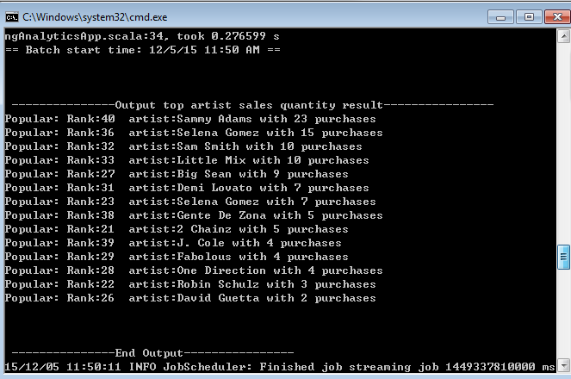
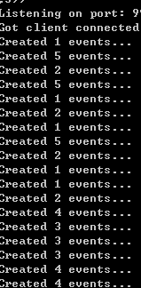
Print result

Slide 11
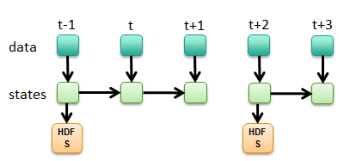

RDD checkpointing
Saving RDD to HDFS to prevent RDD graph from growing too large
Done internally in Spark, saved to HDFS the first time it is computed
red_rdd.checkpoint()
HDFS file
Contents of red_rdd saved to a HDFS file
transparent to all child RDDs

Slide 12
Future
Spark 1.4,1.5 add UI to monitoring the streaming process, code memory and speed optimization.
Deploy on AWS EC2 together with visualization of analysis 24 hours a day
Real shopping date.

